Slide 1

HOUSE PRICE PREDICTON
AUTHOR: ZETHINDRA.M

Slide 2
Table of content
Abstract
Introduction
Methodology
Description
Result
Conclusion
Reference

Slide 3
Abstract
Estimation of value of certain item gives an idea of how to tackle and manage the process of selling or buying that product. When the features of product are less then it becomes easy to predict the price but if you have many features and large amount of data about that product sales it necessary to consider impact of every feature on the price and data of product sales. This project focuses on house pricing in certain locality with the features of the house and the previous data on what the price of house with certain features and finally predicts the price of the house with the new features.
The house pricing dataset for the project contains 8 features and 20,639 sales information. With the help of Python and it’s libraries data was preprocessed to avoid wrong or un-used information and analyzed in the form of graphs to get the relation between the features. Built a Machine Learning model (Regression) for the prediction of prices and evaluation was done to check the accuracy of the model.
The future implementations of the project can be done to predict other sales information of various products.

Slide 4
INTRODUCTION
The project on house price prediction is aimed to predict the price of the house with the given features of house.
The California housing dataset is used in the project which is an real time dataset.
Jupyter Notebook combined with Python scientific libraries are used to make the machine learning model.
Python libraries used are
Pandas
Sklearn
Matplotlib
Seaborn
Xgboost
XGBRegressor is the machine learning model that is trained and tested for predicting house prices in the project
Evaluation of the model is done by calculating Rsquare error and Mean absolute error and graphs are drawn for better understanding.

Slide 5
METHODOLOGY
IMPORT LIBRARIES
DATA COLLECTION
CALIFORINA HOUSING DATASET
Calaculate Co-Relatoion
MODEL BUILDING
Split the data
MODEL EVALUATION
DATA PREPROCESSING
Calculate errors for traning and testing data
START
Convert to pandas DataFrame
Check for null values
Get basic Stats of data
DATA ANALYSIS
Construct a heatmap
Get the ML model
Feed data to that model

Slide 6
DESCRIPRTION
The first step of the project is to import the necessary libraries into the environment
The second step is to load the dataset. Here the dataset is present in sklearn library so it was directly loaded into the environment using fetch() function from sklearn library.
The third step is data pre-processing. Here the raw data was converted into pandas dataframe. First only the features are converted into dataframe from the entire raw data and after targets were converted into dataframe. At last the two data dataframes are combined to form the original dataframe using concat() function. Null values were analysed and some basic stats of data were drawn.
The fourth step is data analysis. Here co-relation of the data between different features of the data is calculated using corr() function. A heatmap is constructed to understand the co-relation.
The fifth step is model building. First we split the data into training and testing data. After that we get the desired machine learning model and feed the data to machine learning model.
Next we predict values (prices) for training and testing data using predict() function.

Slide 7
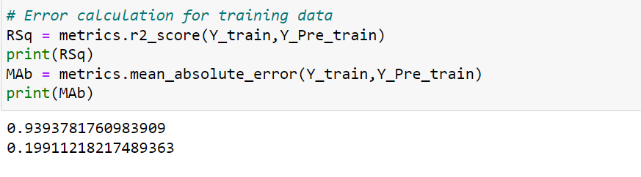
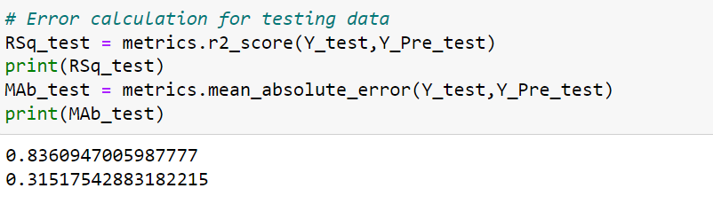
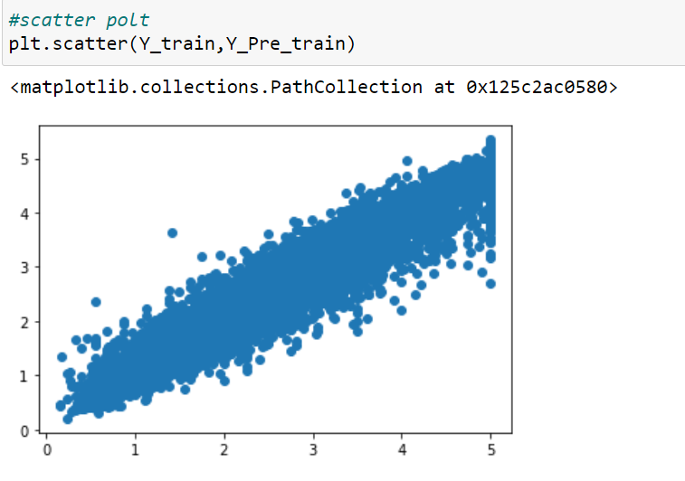
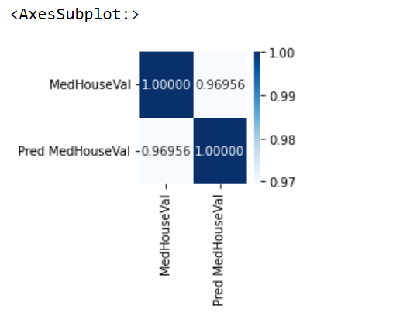
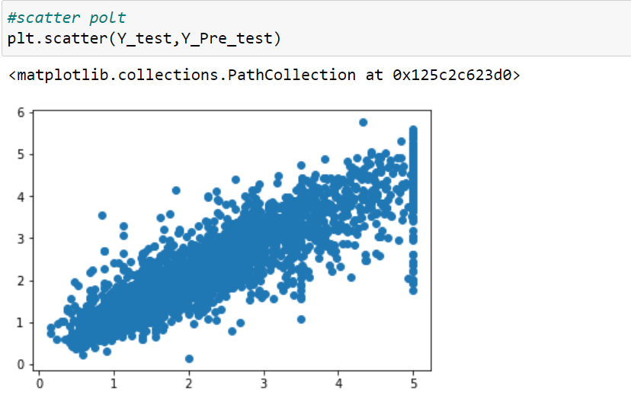
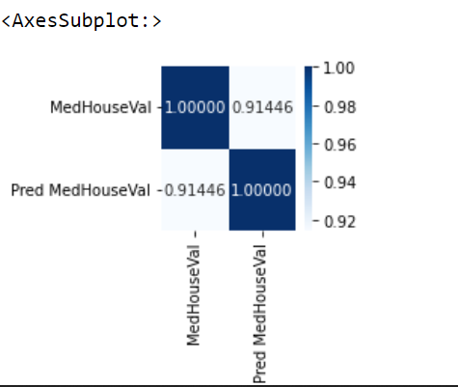
RESULT
Results were analyzed by calculating the errors between actual price values and predicted price values.
For this Rsquare error and Mean absolute error were calculated.
For more understanding of the results scatter plots and heatmaps were constructed between actual price values and predicted price values.
So, the final results are as follows :

Slide 8
CONCLUSION
From the above results we can say that, machine learning model performs well on both training and testing data.
The accuracy of the model can be still improved by pre-processing data and using some dimensionality reduction techniques. This way we can use machine learning for prediction of house prices.
REFERENCES
www.kaggle.com - for dataset
www.w3schools.com/python/pandas - for pandas and data pre-processing

